Slide 1
Microservices
And domain-driven design (DDD)
Ralph.squillace@Microsoft.com

Slide 2
The short version
What a microservice architecture is
Why now
What you need to know

Slide 3
My version of 12factor.net:
All stuff in origin/master, or it goes there.
Microservice code and config completely autonomous.
All non-domain resources are autonomous addressable resources.
Building, releasing, and running are autonomous.
Microservice goal: one stateless process.
Caveat: when point of service is to do multiprocess or stateful work (dbs).
If service is hosted in other framework, microservice treats framework as part of microservice as a unit.
Don’t block. Ever.
Throw problems away and start a fresh un-problem.
Test in production.
Logs are live test streams; see previous.
Admin processes: rarely, but against live code. See previous^2.

Slide 4
My version of Martin Fowler: “While there is no precise definition of this architectural style, there are certain common characteristics around organization around business capability, automated deployment, intelligence in the endpoints, and decentralized control of languages and data.” -- http://martinfowler.com/articles/microservices.html
Components are called “services”
Services based on business capabilities or processes, not skills.
Services are never finished, even when shipping.
Simplest communication possible (REST/oauth2); service logic can be complex.
Note: this is NOT the SOA approach!
Destroy implementation code/library standards. Only service façade and behavior matters.
Data just more microservices.
Automate EVERYTHING.
Failure is a normal part of entropy.
Chaos Monkey, the Simian army, and the Circuit Breaker pattern.
Evolutionary design – see point three, above.

Slide 5
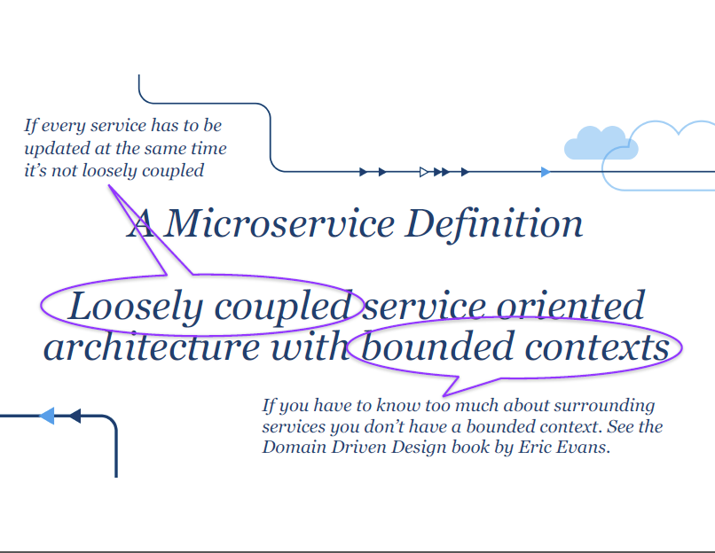
Adrian Cockroft’s version of Adrian Cockroft (formerly of netflix)

Slide 6
Let’s break out the similarities:
Services are focused, entirely self-sustaining, largely single processes.
Everything external to the domain context of the service is a REST call (98% case) to another service for that domain.
Never tell the team how to build the service from the point of view of another service.
Failing services are destroyed and replaced as fast as possible. Period.
At scale, monitoring, logging, and testing are identical.

Slide 7
Thing to grok: Microservices are autonomous single processes
What does this even mean?
Means everything necessary to do that thing are in the service, and no more.
All the code
All the configuration
Nothing, not one thing, more
Architectural issue:
Java app inside tomcat?
Nginx and mysql?
Nginx and redis/memached?

Slide 8
Cache
SMS API
DB
Web
We could stuff everything into one service...

Slide 9
C4: redis
C2: sms
C3: db
C1: web
We’ll pick functionally atomic units to turn into services.

Slide 10
db (C3)
Read/Cache
Write
redis (C4)
sms (C2)
web (C1)
We need 4 services so that we can scale components independently.

Slide 11
db (C3)
db (C3)
db (C3)
Read/Cache
Write
redis (C4)
sms (C2)
web (C1)
sms (C2)
web (C1)

Slide 12
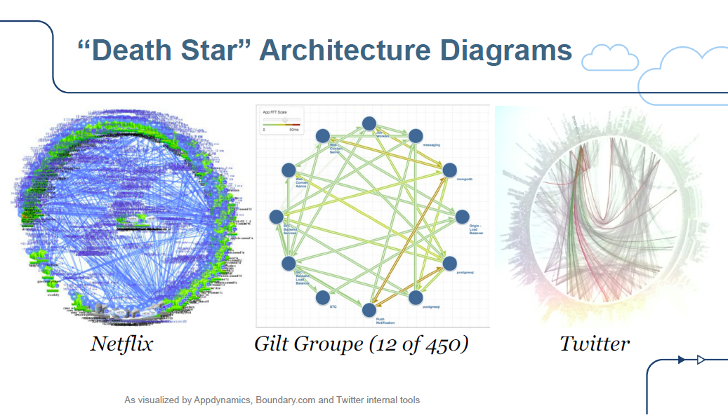
Thing to grok: Apps comprised of microservices can be…
-- Adrian Cockroft (https://github.com/squillace/leap2015/raw/master/AdrianCockroftNetflixMicroservicesOverview.pdf)

Slide 13
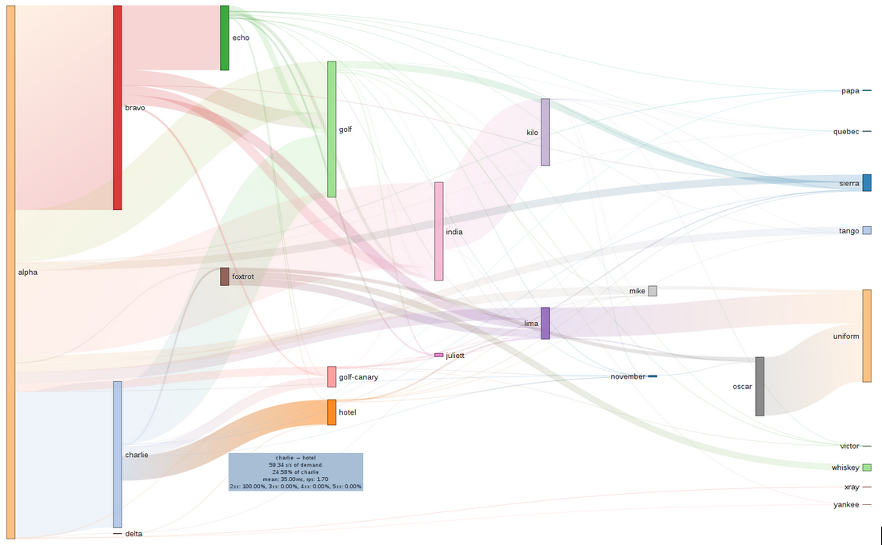

Slide 14
Independence means service code is immutable
Existing services are never changed; new service code deployed as a new service group – nothing changes until routing changes.
A/B, Multiworld, or rolling upgrades
First users are dev/test
Add small random users while measuring
Becomes universally default, with previous service instances running just in case.

Slide 15
Things to grok: edit your microservice specification violently
Everything external to the domain context of the service is a REST call (98% case) to another service for that domain.

Slide 16
Things to grok: know precisely your microservice’s domain
This is, in essence, the ability to understand what you own and what you do not.
*(and stick to it)
NOT. SIMPLE.
Means you might dabble in….

Slide 17
Digression: Domain-driven design: DDD

Slide 18
Book: Eric Evans, Domain-driven Design (2003)
At a high level, much of the approach is already part of common knowledge:
Primary focus is on core domain and domain logic
Designs are based on evolving model of that domain
Core Concept to keep in mind
Bounded Context

Slide 19
My take on DDD – uh, yeah.
Understand, model precisely, communicate, and iterate over the model of a specific bounded context.
Models abound; this model only makes sense in a specific context.
You avoid huge problems if you try to stretch models beyond their context.
Example: An address object might have “commonality” but it might not, also. But it does inside our microservice.

Slide 20
My take on DDD, Part Two
There are funny things about the original works and up to and including work on it in 2010.
Was focused on work done in object-oriented systems, which were hard to scale out. Largest thrust was on scoping down and focusing on controlling inputs and outputs of components (not called “services” originally).
“services” were mentioned: operations that do not conceptually belong to objects. ☺
Microsoft’s take in 2009 guidance: “In order to help maintain the model as a pure and helpful language construct, you must typically implement a great deal of isolation and encapsulation within the domain model. Consequently, a system based on Domain Driven Design can come at a relatively high cost. While Domain Driven Design provides many technical benefits, such as maintainability, it should be applied only to complex domains where the model and the linguistic processes provide clear benefits in the communication of complex information, and in the formulation of a common understanding of the domain.”

Slide 21
My take on DDD, Part Three
Hilarious. Sounds like, if you embrace the microservice way, you’re going to be embracing a strongly domain-driven design approach. Each microservice has its own strongly bounded domain context; they are immutable once deployed; they expose only their own contracts; they perform only one business task.
Performing your work this way leads you directly into a strong consideration of another approach, Command Query Responsibility Segregation (CQRS), which is an approach that firmly keeps read requests separate from write requests.
Finally, note that DDD says nothing about persistence. That is not part of “the model”.

Slide 22
Things to grok: Don’t order the code
Never tell the team how to build the service from the point of view of another service. Don’t systematize on libraries or code across services.
C++ is great
Python is lovely
Javascript even better
Haskell – sure, why not
We’re big fans of C#...
YOU. DO. NOT. CARE.
If the inputs, outputs, throughput, and failure rates are met, it’s gold. They get power, and the responsibility that comes with it.
But they’ll need your guidance. ☺

Slide 23
Thing to grok: Throw it away, NOW.
If the point of a bunch of services is independence and the ability to survive errors, then when there’s an error, collect what you need and throw it away.
NEVER connect to a service to manually debug. What are you thinking?

Slide 24
Digression: You cannot stop entropy!!
The universe tends to disorder and chaos. Work with it, not against it.
Information: A History
Antifragile: Things that Gain From Disorder
Rental computers break. Software on rented computers has bugs
Thus: Bic diposable services! (Does everyone know Société Bic? Most famous French company in the United States that no one knows it’s French.)
Digression: “Between 1949 and 1950 the Bic Cristal was designed by the Décolletage Plastique design team at Société PPA (later Société Bic).”
Designed well, the most you’ll lose is ongoing processing state; perhaps one user might have to retry something… at scale, that’s just fine.
Caveat: stateful services like db services will of course be designed to high-availability and failover in and of themselves, so even they can be torched individually in the worst cases.

Slide 25
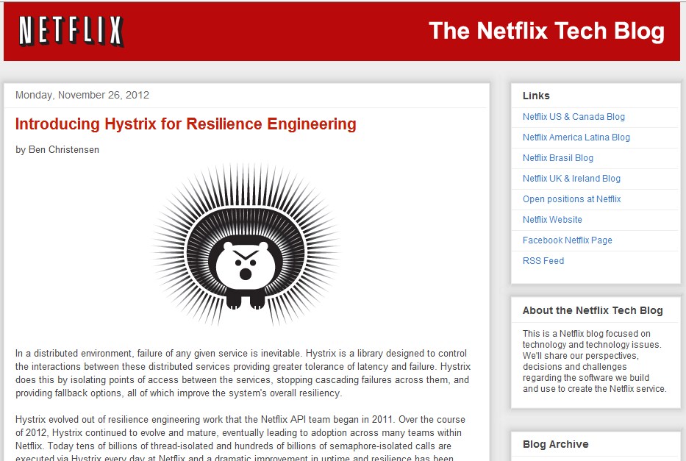

Slide 26
Point: if things fail, design for failure
Story: disks fail constantly. In a datacenter, disk are constantly failing. You should expect that each component of your application could hit that disk at any time. Your components should think that’s normal – it’ll happen to them.

Slide 27
Point: Do you wash your rental car?
I didn’t think so….
So, if you’re renting computers, why don’t you burn them up?
RUN YOUR MACHINERY HARD.
Containers
Chaos Monkey
Failure detection
STORAGE strategy: distributed redis into blobs, json blobs (“documents” -- mongodb) and sql backends
Etc.

Slide 28
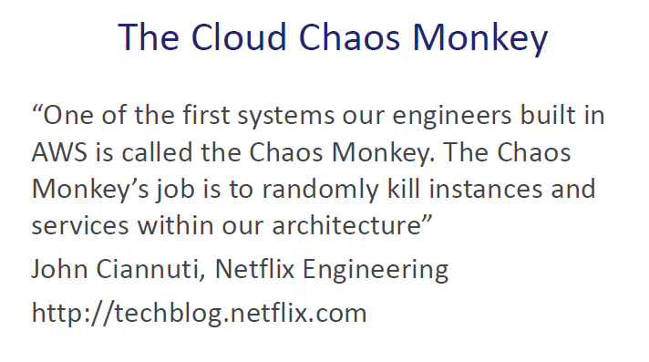
The Chaos Monkey Lives!!!

Slide 29

Point: CAP theorem pushes us towards A and P
We must choose between the three; entropy (and wide experience in distributed systems!) teaches us that C(onsistency) is not one of the top two
With one exception: When it is the point of the application. Only then.
-- Adrian Cockroft

Slide 30
Point: Smallest possible partitioned resource
VMs should be smallest
OS should be smallest
Bunches of storages with partition and retry policies
Benefits:
Fine grained scale-out and scale-in
Each failure much smaller portion of entire load
Cost (Duh)

Slide 31
Implications for humans
Ah, execution. Tough stuff.

Slide 32
Implications for humans
Developers think they gain impact; they’re right. They also gain complete responsibility for failure.

Slide 33
Implications for humans
Operations focused on hardware drops massively over the next five years.
Operations focused on developing and managing software compute abstractions increases dramatically.

Slide 34
Implications for humans
Architects focus on everything more and more.
Datacenters are now programs. Programs in datacenters are programs running in programs.

Slide 35
Implications for humans
Because everyone has more focus on apps and infrastructures as apps, that means….
Reorg!!!

Slide 36
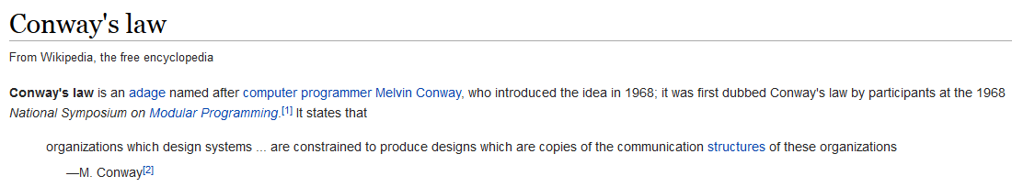
Implications for humans
Use Conway’s law to our advantage
http://en.wikipedia.org/wiki/Conway%27s_law

Slide 37
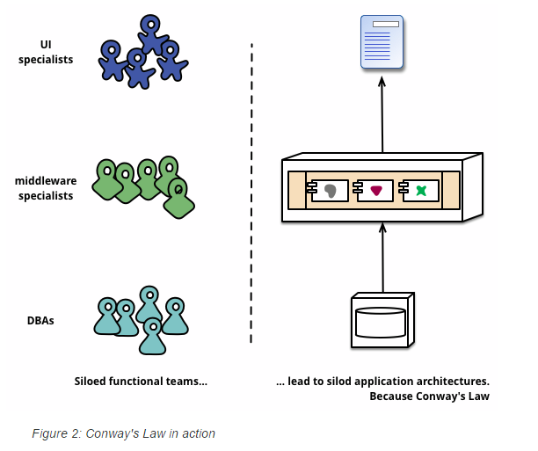
Implications for humans

Slide 38
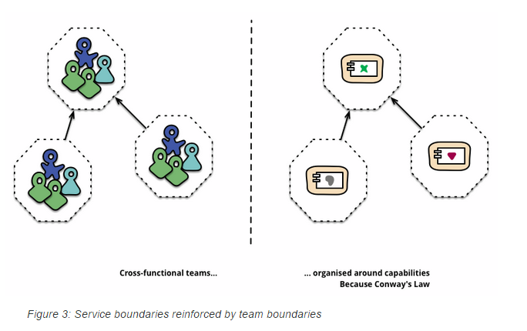
Implications for humans

Slide 39
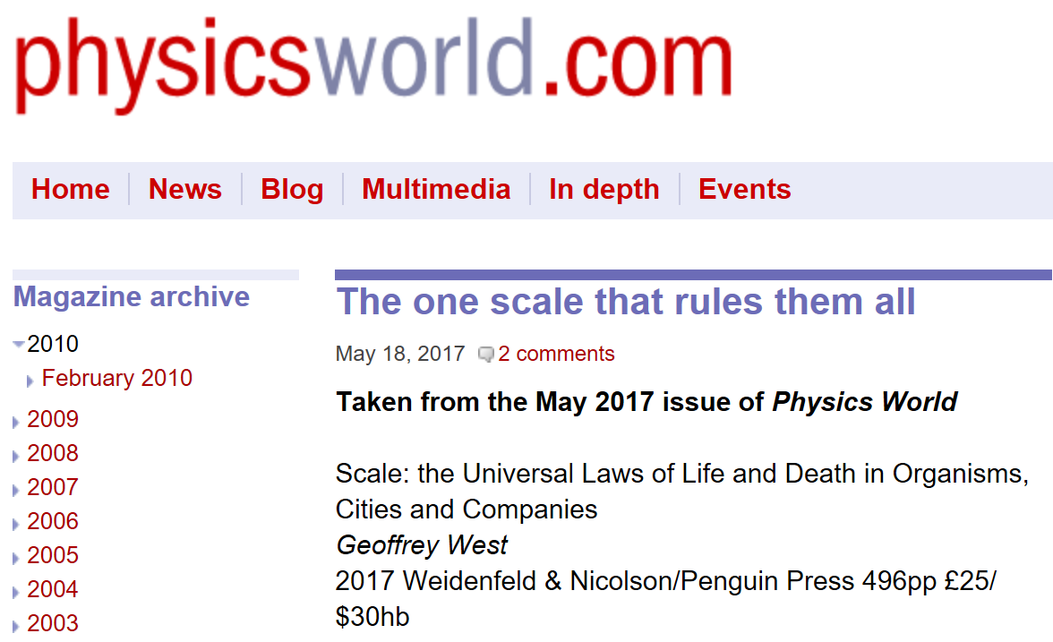
Scaling out has consequences
http://physicsworld.com/cws/article/print/2017/may/18/the-one-scale-that-rules-them-all

Slide 40
Scaling with Animals not like cities – or software, but…
Cities behave very differently, according to West. They show the same sublinear scaling when it comes to infrastructure: the bigger the city, the more efficient the distribution of its roads, cables, gas stations, power lines, railways and other infrastructure, so the fewer of those a city needs.
-- from Scale: the Universal Laws of Life and Death in Organisms, Cities and Companies by Geoffrey West

Slide 41
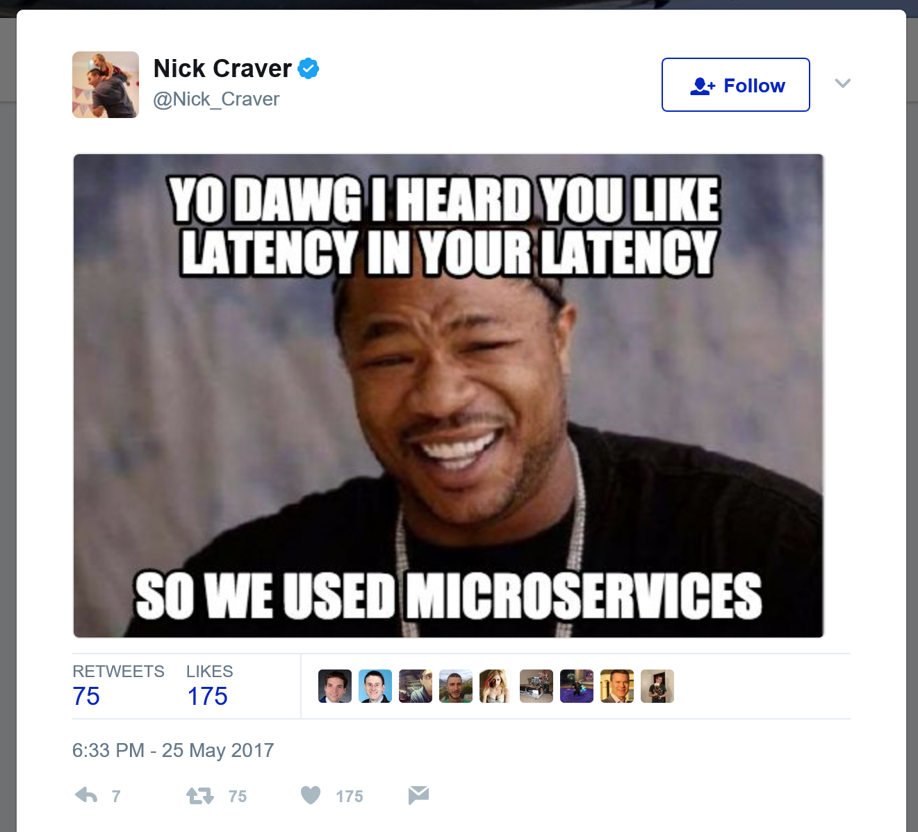
Issues: so….

Slide 42
8 ways to go wrong
You are not Netflix, stop trying to be them!﻿
Stop worrying about Small! The 'Micro'services label sucks
You must go public cloud or 'Cloud Native’
Thinking that you must use Docker, or containers
Thinking that you must worry about exactly how many lines of code are in your microservices
Thinking that this needs to be a big-bang organisational to even work
You MUST use REST, and entity/resource-focussed, communication throughout
You MUST reuse microservices across your organisation
http://www.russmiles.com/essais/8-ways-to-lose-at-microservices-adoption

Slide 43
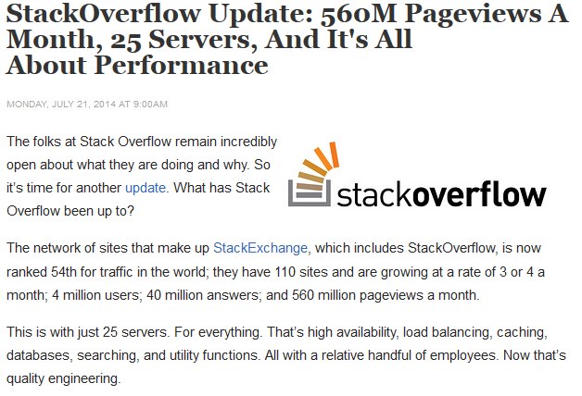
Point: Scale-up works if…
Stackoverflow.com
The exception that proves the rule.
All with SQL Server!
“Stack Overflow still uses Microsoft products. Microsoft infrastructure works and is cheap enough, so there’s no compelling reason to change. Yet SO is pragmatic. They use Linux where it makes sense. There’s no purity push to make everything Linux or keep everything Microsoft. That wouldn’t be efficient.
Stack Overflow still uses a scale-up strategy. No clouds in site. With their SQL Servers loaded with 384 GB of RAM and 2TB of SSD, AWS would cost a fortune. The cloud would also slow them down, making it harder to optimize and troubleshoot system issues. Plus, SO doesn’t need a horizontal scaling strategy. Large peak loads, where scaling out makes sense, hasn’t been a problem because they’ve been quite successful at sizing their system correctly.”

Slide 44
Things to grok: The app is everything at once
Two or more levels of architecture:
Microservices themselves
How all the microservices work together
The infrastructure that makes them happen – that’s all software now

